Slide 1
NoSQL Databases and Data Modeling Techniques for a Document-oriented NoSQL Database
Bob Mason
Regis University, Denver, CO
College of Computer and Information Sciences
7/3/2015
Notes:
This template can be used as a starter file for presenting training materials in a group setting.
Sections
Right-click on a slide to add sections. Sections can help to organize your slides or facilitate collaboration between multiple authors.
Notes
Use the Notes section for delivery notes or to provide additional details for the audience. View these notes in Presentation View during your presentation.
Keep in mind the font size (important for accessibility, visibility, videotaping, and online production)
Coordinated colors
Pay particular attention to the graphs, charts, and text boxes.
Consider that attendees will print in black and white or grayscale. Run a test print to make sure your colors work when printed in pure black and white and grayscale.
Graphics, tables, and graphs
Keep it simple: If possible, use consistent, non-distracting styles and colors.
Label all graphs and tables.

Slide 2
Today’s Overview
Introduction (tutorial)
NoSQL Databases
Types of NoSQL Databases
Data Modeling Design Techniques for a MongoDB NoSQL Database
Notes:
This is another option for an Overview slide.

Slide 3
Introduction
Big Data - large data stores that were measured in Terabytes are now being measured in Petabytes (1,000 Terabytes)
NoSQL has come to mean databases that are alternatives to the conventional RDBMS
Mohan (2013) cautions that this type of adhoc development approach for NoSQL databases can lead to long-term disastrous results for end users
Notes:
This is another option for an Overview slide.

Slide 4
NoSQL Databases
NoSQL databases are able to support larger volumes of data by providing faster data access and cost savings
A physical architecture that includes the use of inexpensive commodity servers that leverage distributed processing
Traditional RDBMS SAN storage costs average $30,000+ per terabyte, whereas storage for NoSQL databases average $1000 per terabyte
Notes:
This is another option for an Overview slide.

Slide 5
RDBMS - ACID
Atomicity – ensures that all tasks with a transaction are performed completely (all or nothing).
Consistency – ensures that a transaction must leave the database in a consistent state at the end of the transaction.
Isolation – ensures that transactions are isolated and do not interfere with other transactions.
Durability – ensures that once the transaction is complete, the data will persist permanently, even in the event of a system failure.
Notes:
This is another option for an Overview slide.

Slide 6
NoSQL - BASE
CAP theorem (Consistency, Availability and Partition Tolerance) for data consistency (2 out of 3)
Basically Available – means that data will be available, however the response from the database can be a failure to retrieve the data or the data retrieved may be in an inconsistent state.
Soft state – means that the data can change over time as the database seeks consistency.
Eventual consistency – means that sooner or later, the database will eventually become consistent.
Notes:
This is another option for an Overview slide.

Slide 7
NoSQL – Schema Write vs. Read
Schema Write - RDBMS require that the database structure (schemas) must be defined in advance of loading
Schema Read - NoSQL column-family databases, such HBase and Cassandra, provide a flexible schema structure that facilitates changes to the schema definition when new types of data are encountered
Existing database applications that use the database will have to be altered to use the new data structures (Sadalage and Fowler, 2013)
Notes:
This is another option for an Overview slide.

Slide 8
NoSQL – Scaling
Scaling for RDBMS is done vertically and is usually accomplished by adding additional memory and/or CPU to one or more servers.
NoSQL databases can scale both horizontally and vertically
Most commonly, additional nodes (commodity servers) are added to a NoSQL cluster (group of servers) to scale horizontally (called sharding)
Notes:
This is another option for an Overview slide.

Slide 9
NoSQL – Four Types
There are four types of NoSQL databases:
Document-oriented
Key-Value Pairs
Wide Column (or Column Family)
Graph
Notes:
This is another option for an Overview slide.

Slide 10
NoSQL – Document-oriented
Stores denormalized related data in the form of a document. (e.g. MongoDb)
Sample Data
Book Title: Business Intelligence and Analytics: Systems for Decision Support
Authors: Ramesh Sharda, Dursun Delen, Efraim Turban
Publication Date: 2015
Edition: 10th
Publisher: Pearson
Publisher Location: Upper Saddle River, NJ:.
ISBN-13: 978-0-13-305090-5
Notes:
This is another option for an Overview slide.

Slide 11
NoSQL – Key-Value Pairs
Stores information in form of matched pairs with only two columns permitted - the key (hashed key) and the value (e.g. Project Voldemort, Cache and Dynamo)
Sample Data
Key Value
Book Title Business Intelligence and Analytics: Systems for Decision Support
Author (set) Ramesh Sharda
Dursun Delen
Efraim Turban
Pub. Date 2015
Notes:
This is another option for an Overview slide.

Slide 12
NoSQL – Wide Column (Column Family)
Format of data storage that is very similar to RDBMS and includes complex data types, unstructured text and graphics (e.g. Hbase, Cassandra)
Sample Data
Title: Business Intelligence and Analytics: Systems for Decision Support
Book Details (includes authors, year, etc.)
Ramesh Sharda, Dursun Delen, Efraim Turban
2015
Notes:
This is another option for an Overview slide.

Slide 13
NoSQL – Graph
Supports data that has an undefined number of network connections (e.g. Allegro, Neo4j and Virtuoso)
Sample Data
Notes:
This is another option for an Overview slide.

Slide 14
MongoDB Embedding vs. References
Data that is that is frequently queried from multiple entities at the same time can be embedded into one document.
Entities that are considered dependent entities can be embedded into one entity.
If there is a one to one relationship between two entities, we embed one of the entities into the other entity.
Entities that experience similar volatility (inserts, updates and deletes) at the same rate can be embedded together.
Entities that are not key entities, but have relationships with key entities, can be referenced and not embedded.
Hoberman (2014)
Notes:
This is another option for an Overview slide.

Slide 15
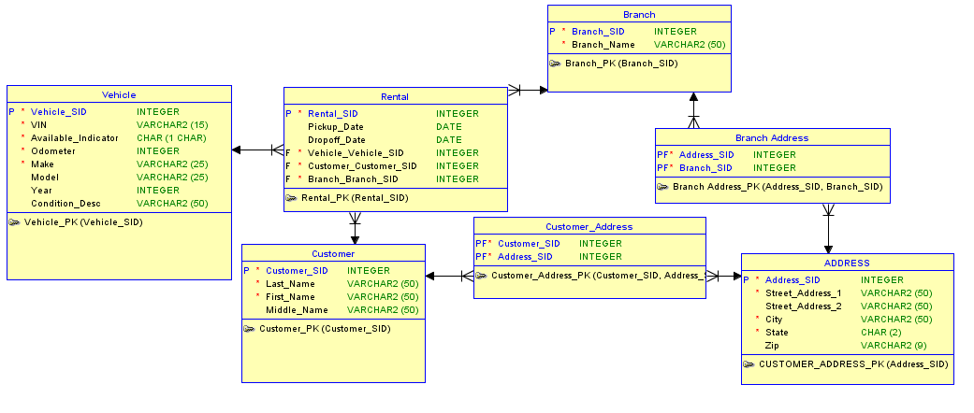
Data Model in 3rd Normal Form
Notes:
This is another option for an Overview slide.

Slide 16
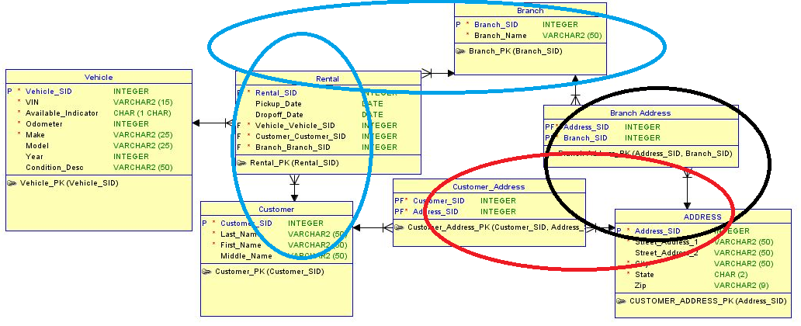
Groupings for a Rental Car LDM
Notes:
This is another option for an Overview slide.

Slide 17
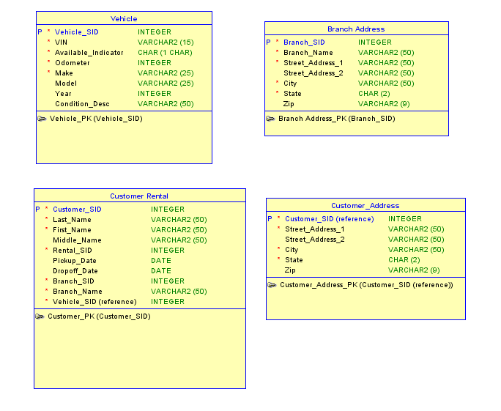
Applied Groupings
Notes:
This is another option for an Overview slide.

Slide 18

Summary
NoSQL Databases
Types of NoSQL Databases
Data Modeling Design Techniques for a MongoDB NoSQL Database
Notes:
Summarize presentation content by restating the important points from the lessons.
What do you want the audience to remember when they leave your presentation?
Save your presentation to a video for easy distribution (To create a video, click the File tab, and then click Share. Under File Types, click Create a Video.)

Slide 19
Questions?
Notes:
Microsoft Engineering Excellence
Microsoft Confidential

